Slide 1
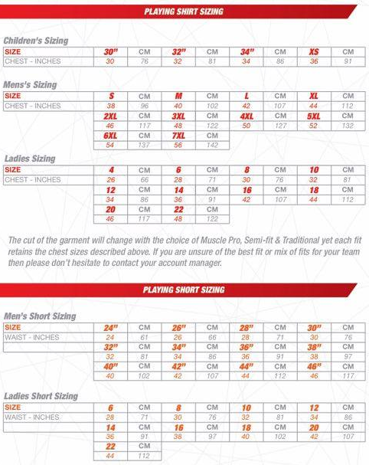
PLAYING KIT SIZES

